Slide 1
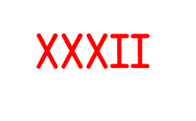
Year 4 | Week 9 | Day 1

Slide 2
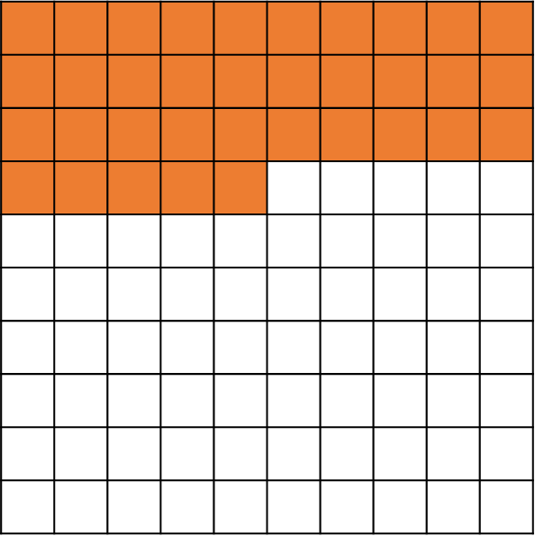
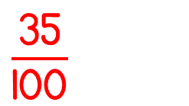
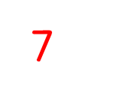
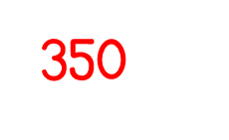
Year 4 | Week 9 | Day 2

Slide 3
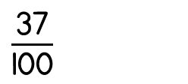
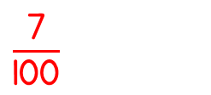
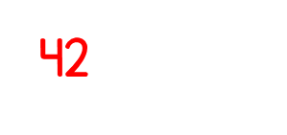
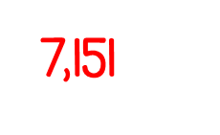
Year 4 | Week 9 | Day 3

Slide 4
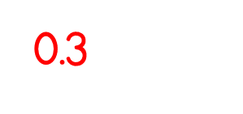
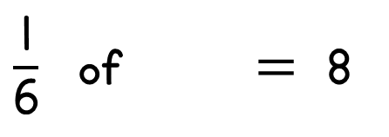
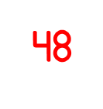
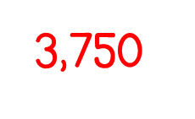
Year 4 | Week 9 | Day 4

Slide 5
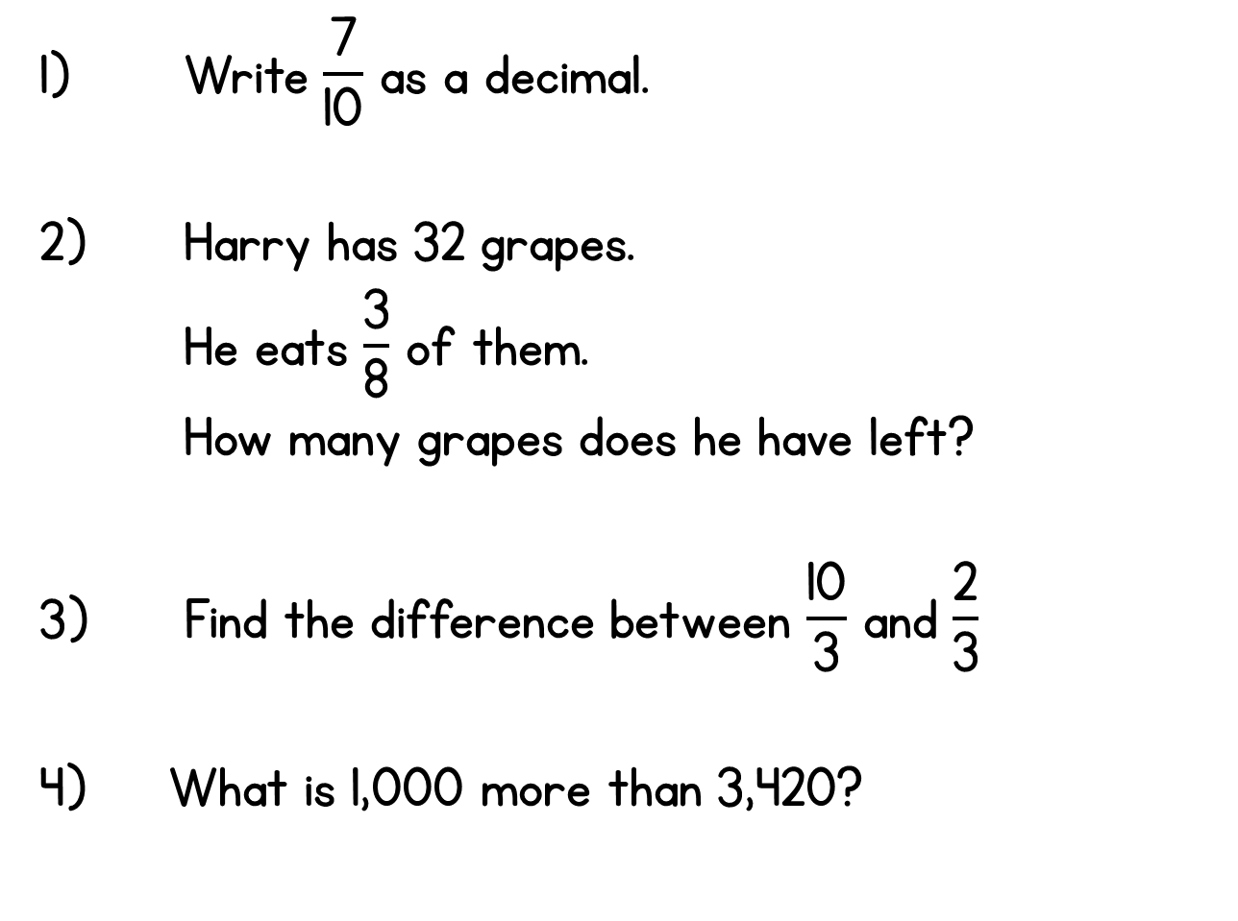
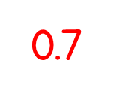
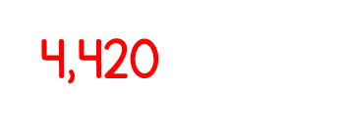
Year 4 | Week 9 | Day 5

Slide 6
Year 4 | Week 10| Day 1

Slide 7
Year 4 | Week 10 | Day 2

Slide 8
Year 4 | Week 10 | Day 3

Slide 9
Year 4 | Week 10 | Day 4

Slide 10
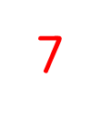
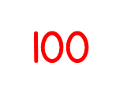
Year 4 | Week 10 | Day 5

Slide 11
Year 4 | Week 11 | Day 1

Slide 12
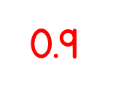
Year 4 | Week 11 | Day 2

Slide 13
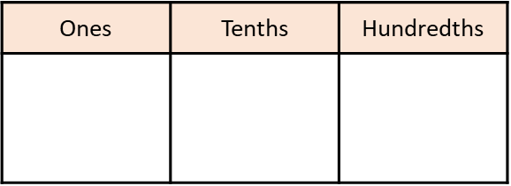
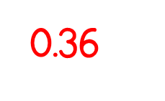
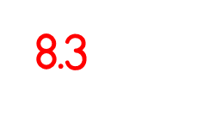
Year 4 | Week 11 | Day 3

Slide 14
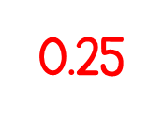
Year 4 | Week 11 | Day 4

Slide 15
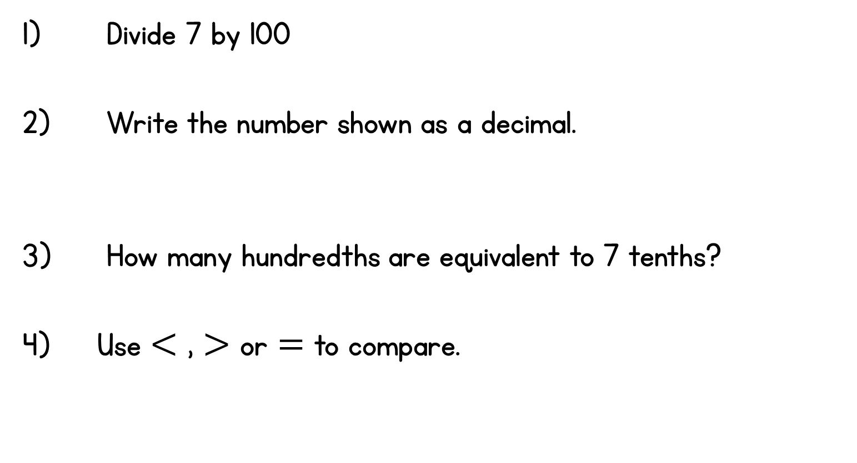
Year 4 | Week 11 | Day 5
$\frac{\text{1}}{\text{8}}$ of 320 320 $÷$ 8

